Slide 1
Open Frame Tablet ARM Embedded Solutions Department

Slide 2
(picture from Google)

Slide 3
Concept
Low cost & low power panel PC like tablet
Power on without battery
Fully flat touch screen
Slim design but with strength
Fit into any embedded applications
Compatible with multi-OS platform

Slide 4
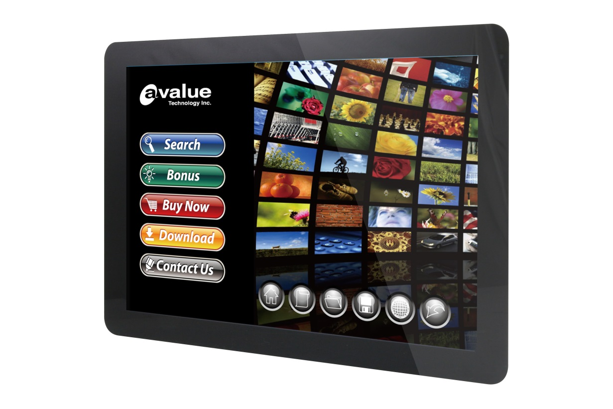
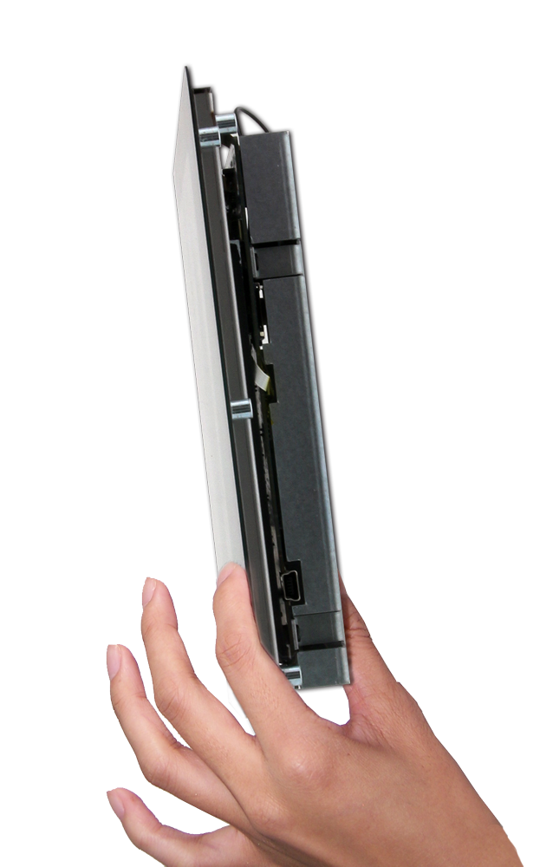
Open frame tablet

Slide 5
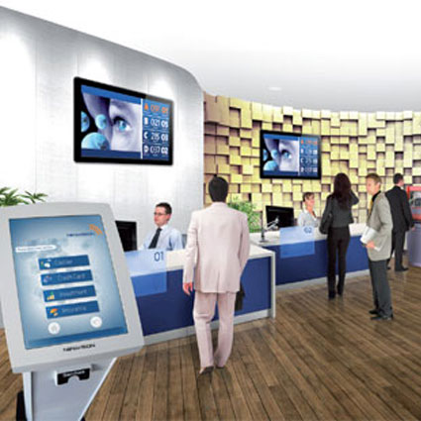
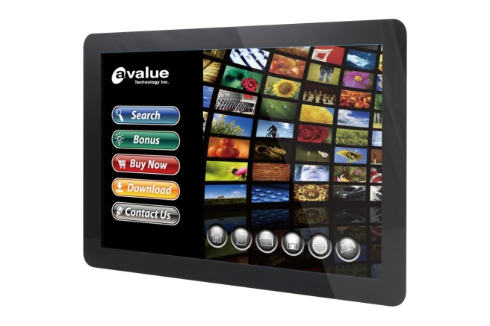
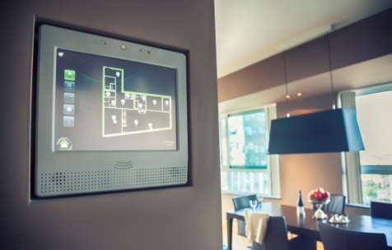
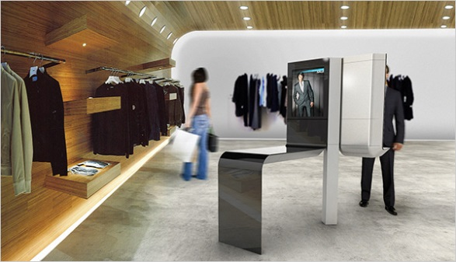
Application
(picture from Google)

Slide 7
Bay Trail T-CR Z3735F

Slide 8
Benchmark with ARM
 | Intel ATOM Z3735F | Rockchip RK3188 | Freescale i.MX6Q
 | Quad core @ 1.33 GHz (Burst 1.83GHz) | Quad Core Cortex-A9 @ 1.6GHz | Quad Core Cortex-A9 @ 1.0GHz
Antutu 5.X
Overall | 29851 | 21900 | 11104
Multitask | 3947 | 4438 | 2049
Runtime | 2064 | 1352 | 713
RAM Ops | 2158 | 2303 | 1018
RAM Speed | 3281 | 1179 | 519
CPU Integer (multi-thread) | 3035 | 2048 | 938
CPU float-point (multi-thread) | 2984 | 2403 | 1098
CPU Integer (single thread) | 1572 | 1303 | 636
CPU float-point (single thread) | 1696 | 1450 | 693
2D Graphics (1920×1080) | 1346 | 1052 | 609
3D Graphics (1920×1080) | 5904 | 3013 | 312

Slide 9
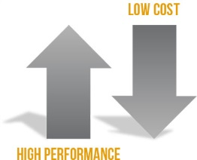
Cost-performance
Intel E3845/
J1900
Intel
Z3735F
Low ----- Performance ------ High
Freescale i.MX6Q
Low ------------ Cost ------------- High

Slide 10
OFT-07W01 Feature
1GB or 2GB RAM
8GB or 32GB eMMC
802.11 b/g/n WiFi
Integrated antenna
10/100 LAN Ethernet
Preboot eXecution Environment
12V to 19V DC input

Slide 11
OFT-10/15/21W01 Feature
2GB RAM
8GB or 32GB eMMC
802.11 b/g/n WiFi
Integrated antenna
10/100 LAN Ethernet
Preboot eXecution Environment
12V to 19V DC input
Optional POE 802.3AT (10” only )

Slide 12
4 Panel Size
Panel |  |  |  | Touch
Size | Resolution | Luminance | View Angle (H+-)/ (V+-) | Touch | Bonding | Surface hardness
7" | 1280*800 | 300 | 165° (H/V) | PCAP | Air bonding | 6H
10.1" | 1280*800 | 350 | 170° (H/V) | PCAP | Air bonding | 6H
15.6" | 1920*1080 | 200 | 89°/89°/89°/89° | PCAP | OH-cell | 6H
21.5" | 1920*1080 | 250 | 178°(H/V) | PCAP | on-cell | 6H

Slide 13
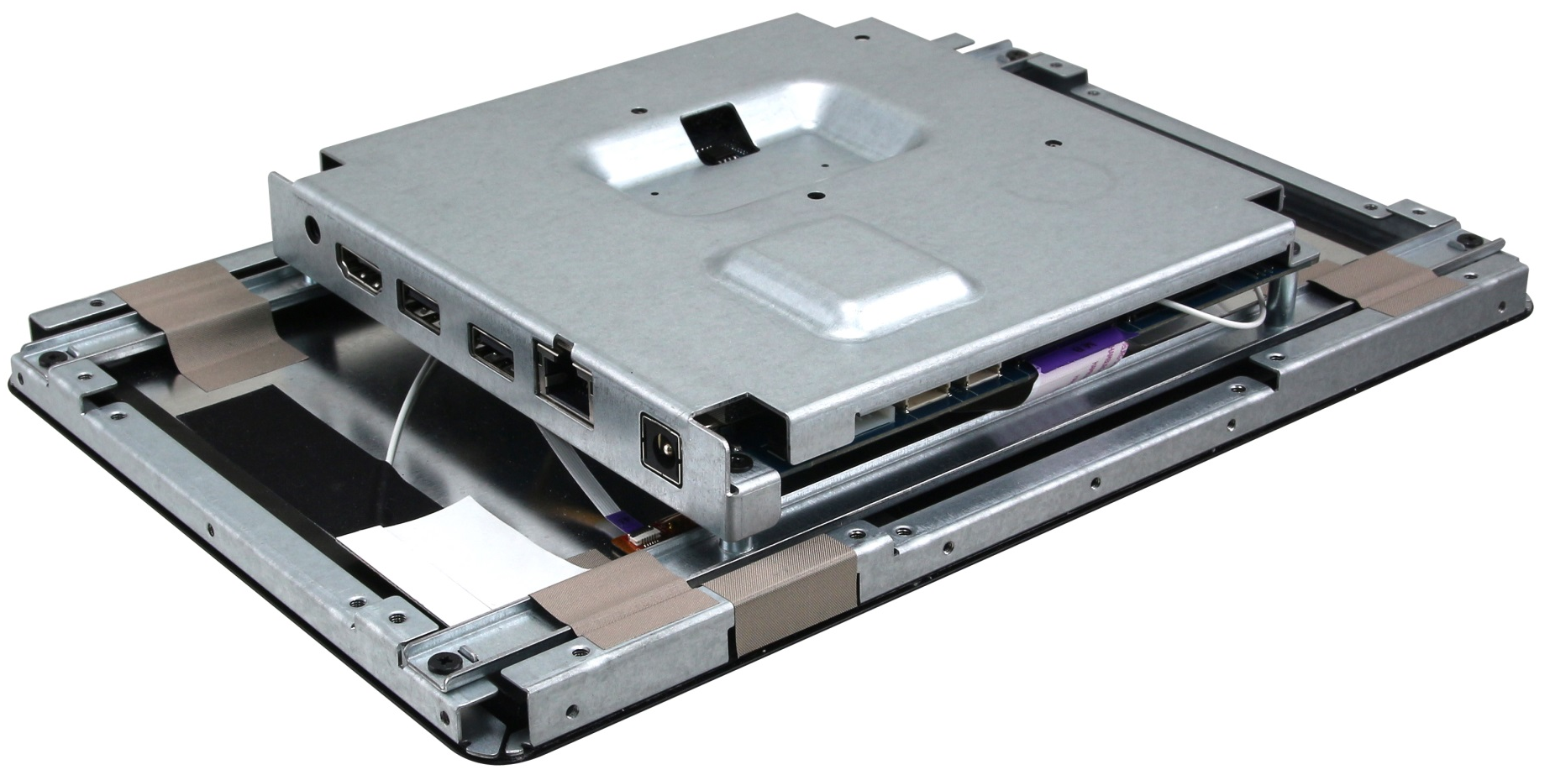
External IO
Micro SD
Audio Jack
HDMI
USB2.0*2
LAN Port
DC Jack

Slide 14
Internal IO
RS485
Touch
Button
Speaker
USB
RS232
GPIO
A-MIC
DC input 4pin header

Slide 15
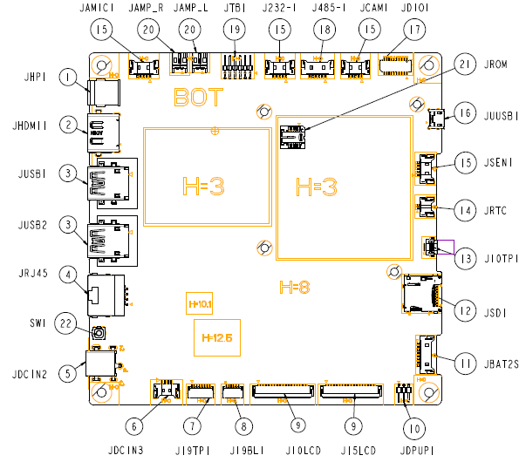
Placement

Slide 16
Back Mounting Design
Example:10W01
Front view
Side view

Slide 17
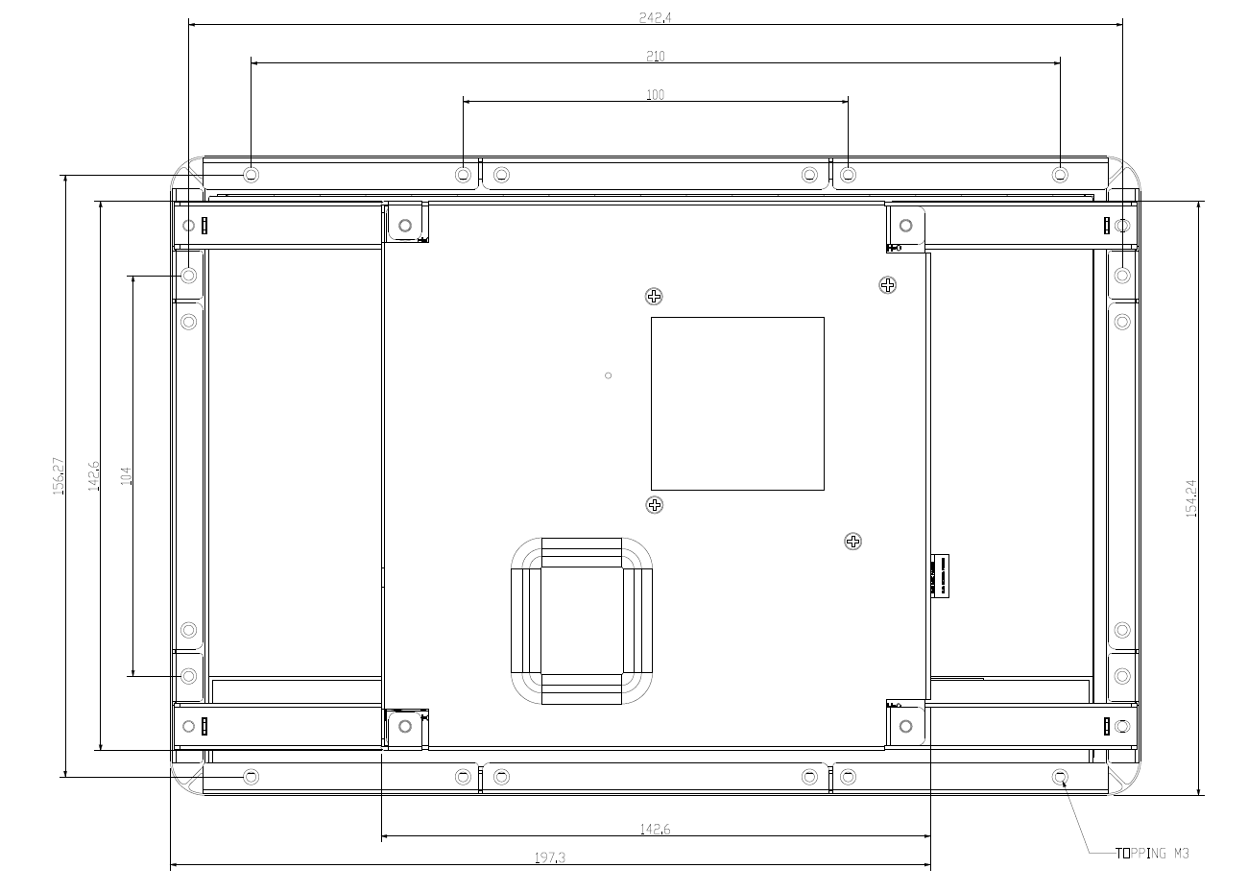
Back Mounting Design
Example:10W01
Back view

Slide 18
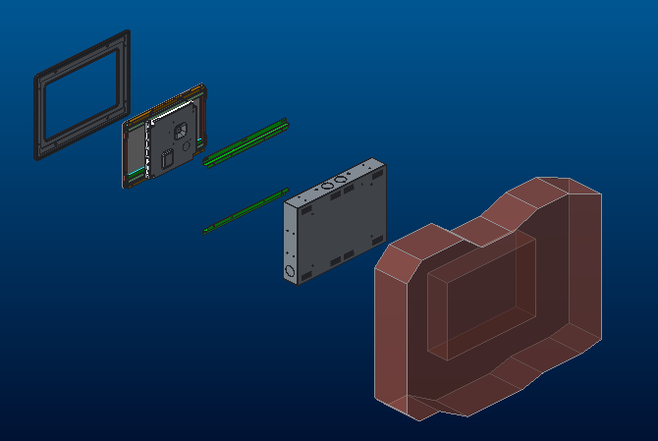
Wall mount
Reference Design 1
Front bezel
OFT-10W01
Panel bracket
Wall box
Wall

Slide 19
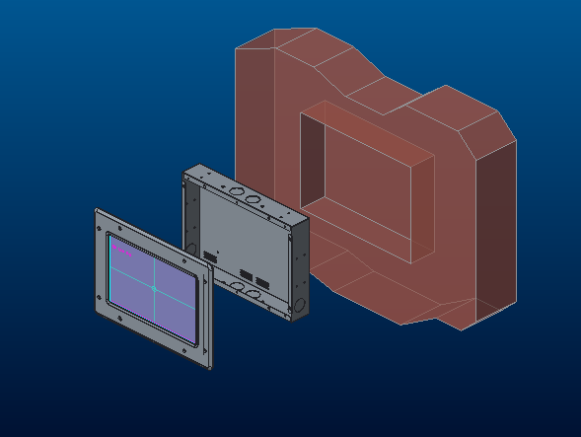
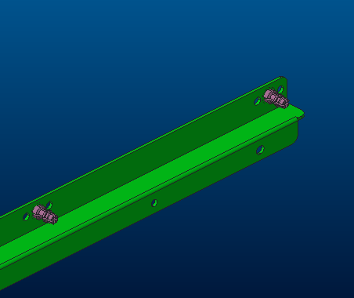
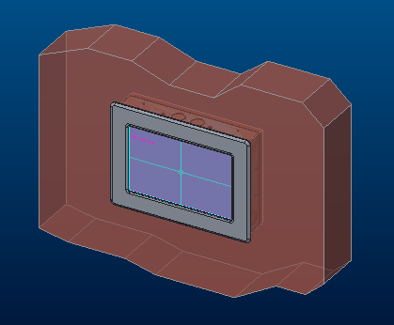
Wall mount
Reference Design 1
Customization fixture
Wall box
Wall
OFT-10W01 with front bezel

Slide 20
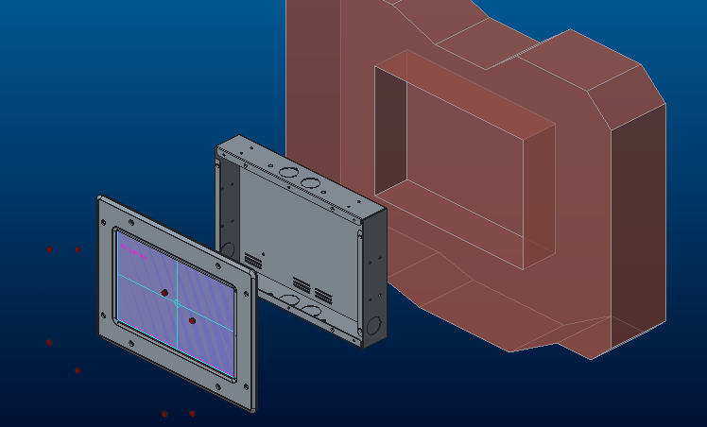
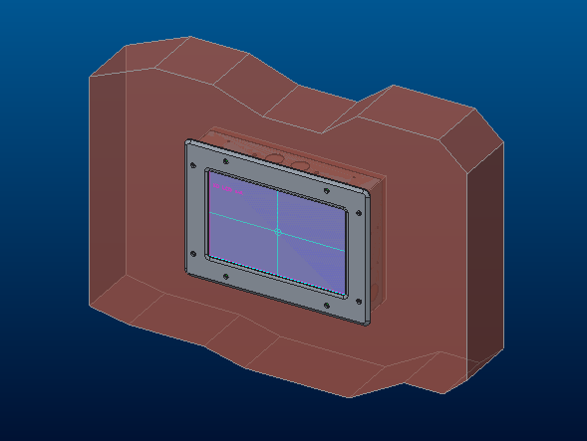
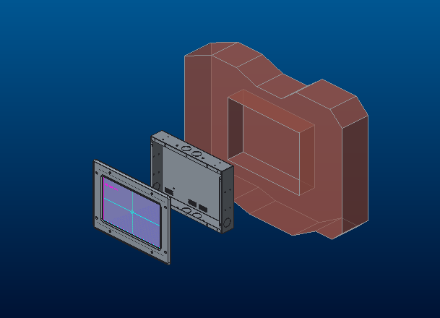
Wall mount
Reference Design 2
Wall box
Wall
Screw cover
OFT-10W01 with front bezel

Slide 21
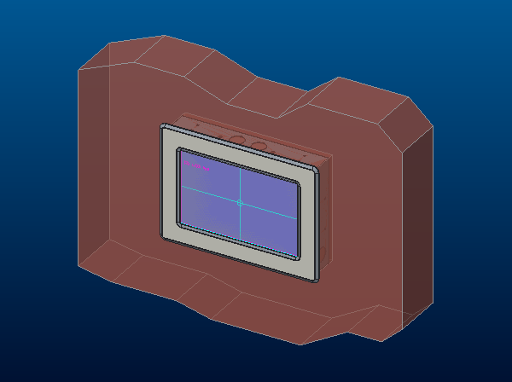
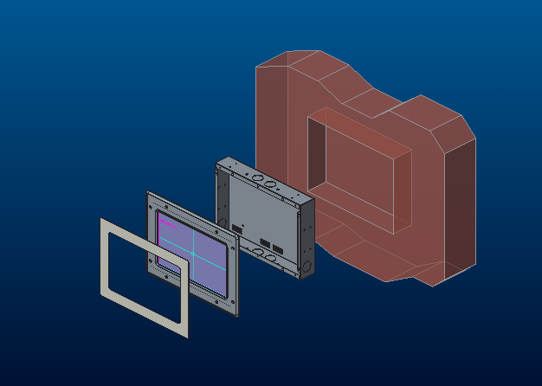
Wall mount
Reference Design 3
Wall box
Wall
Name plate
OFT-10W01 with front bezel

Slide 22
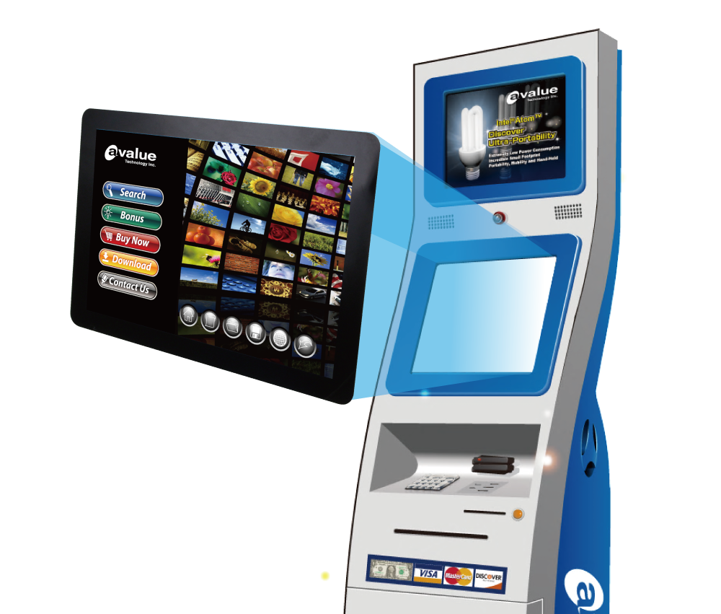

Slide 23
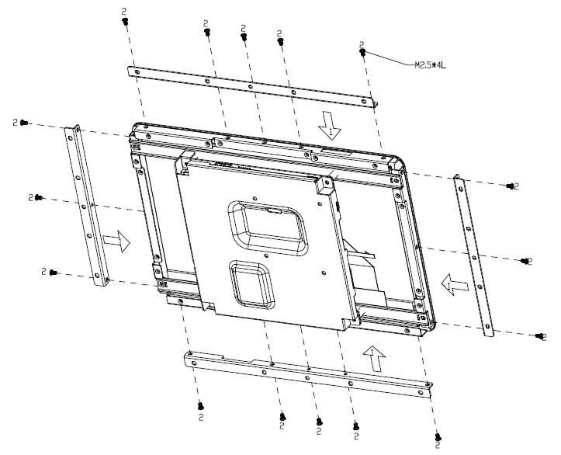
Extended Bracket
*Bracket Sold Separately

Slide 24
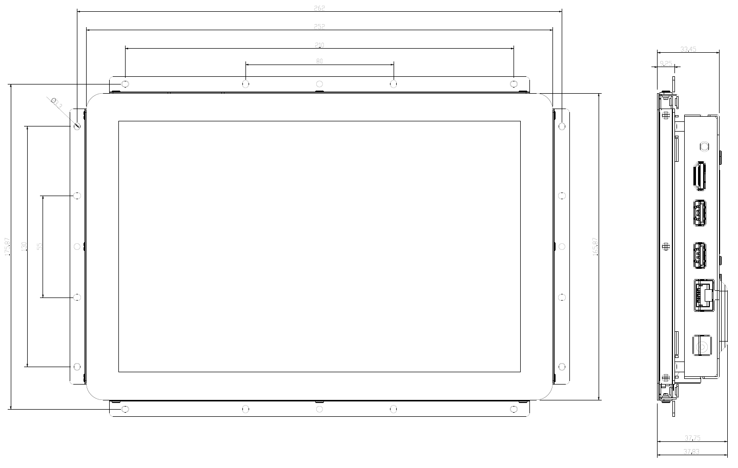
Front Mounting Design
Example:10W01
Front view
Side view
*Bracket Sold Separately

Slide 25
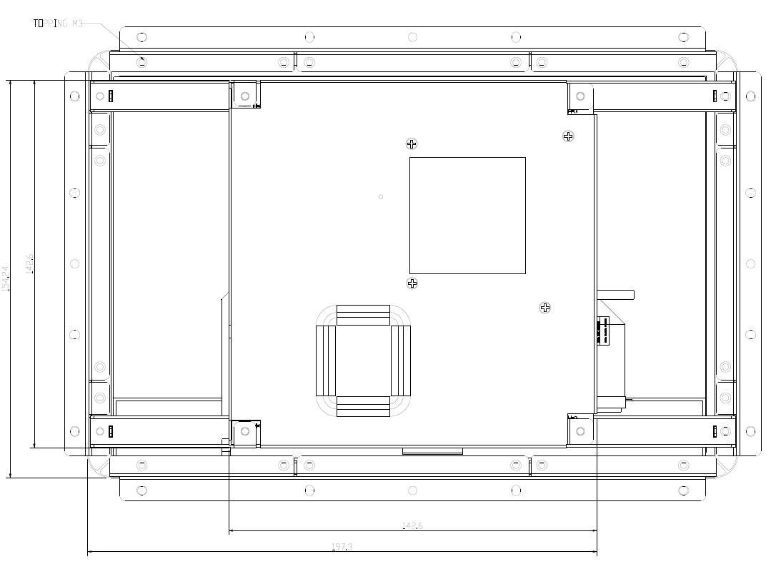
Front Mounting Design
Example:10W01
Back view
*Bracket Sold Separately

Slide 26
Multi-OS Compatibility
Android 4.4
Windows 8.1
Windows 10
Ubuntu 14.04

Slide 28
Q&A
1. Can memory size expand to 2GB above?
2GB
2. Does display support dual-display?
LCD + HDMI Windows/ Linux: extended mode Android: extended mode by APP
3. Can system support 64bit OS?
Android & Ubuntu
4. Can system support 32bit OS?
Windows

Slide 29
Q&A
5. Which Android version is supported now?
Android 4.4 (Kernel 3.10)
6. How to update Android OS?
by SD card/ USB (OTA update)
7. Which Linux distribution is supported now?
Ubuntu 14.04 (Kernel 3.16)
8. Can we provide Linux Kernel source code?
provide kernel installation package (BSP)
9. Which Windows version could be pre-installed now?
Windows 8.1/10 Embedded Industry retail (ePKEA)

Slide 30
Q&A
10. What’s warranty period ?
12+3 months (extra 3 months for delivery/ warehouse)
11.What’s CPU life time guarantee?
3+2 years (2015~2018, extend to 2020)

Slide 32
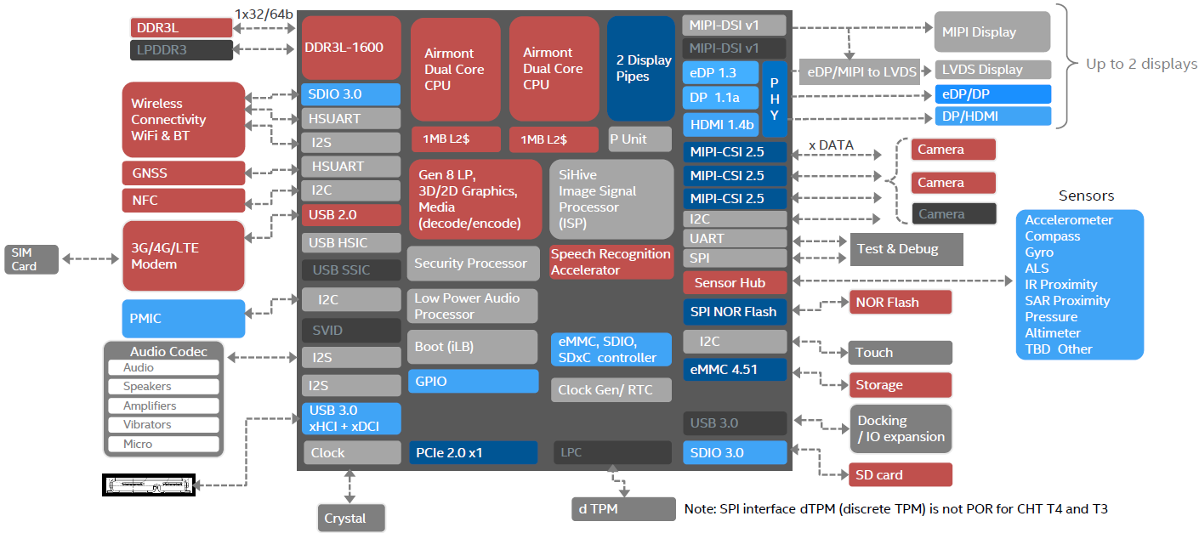
Cherry Trail Z8300
USB 3.0
PCIe 2.0
2 Display Pipes
SDIO 3.0

Slide 33
Roadmap
2015 Q4
2016 Q4
7”/ 10”/15”/21”
Open Frame Tablet
with Bay Trail
7”/ 10”/15”/21”
Open Frame Tablet
with Cherry Trail

Slide 34
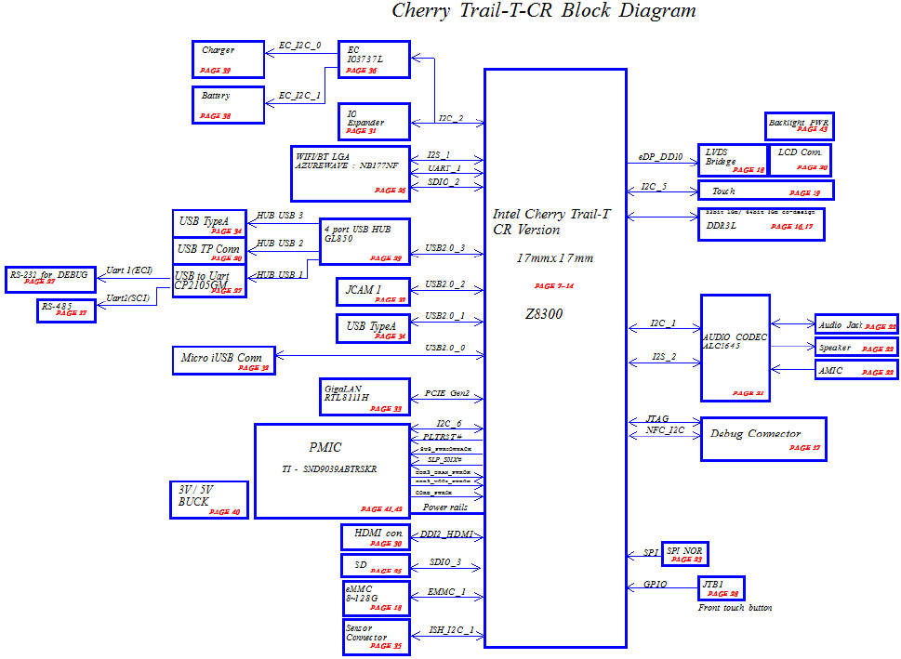
OFT-XXW02 Block Diagram

Slide 35
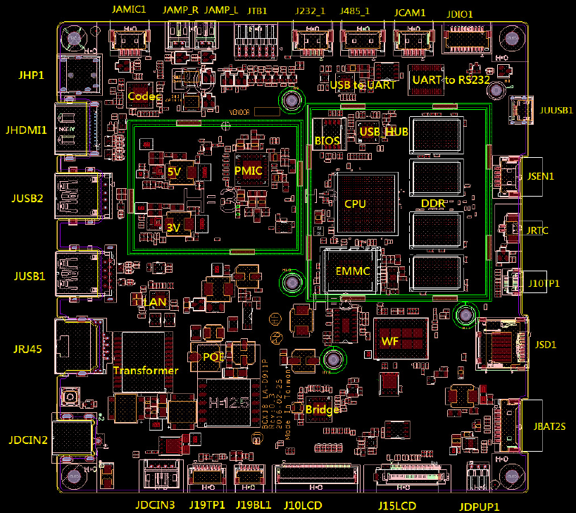
OFT-XXW02 EVT Placement

Slide 36
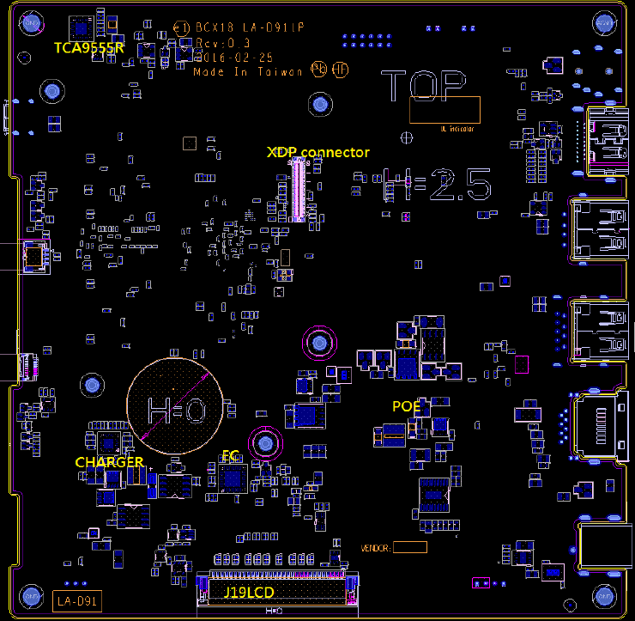
OFT-XXW02 EVT Placement

Slide 37
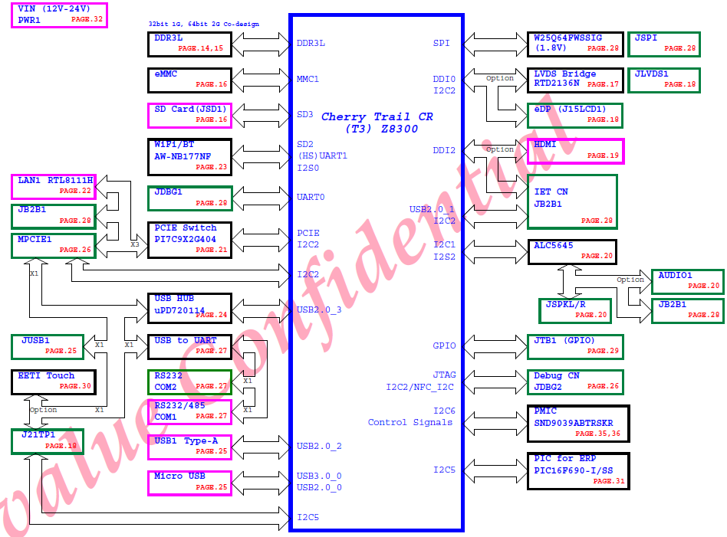
OFT-XX02 Block Diagram

Slide 38
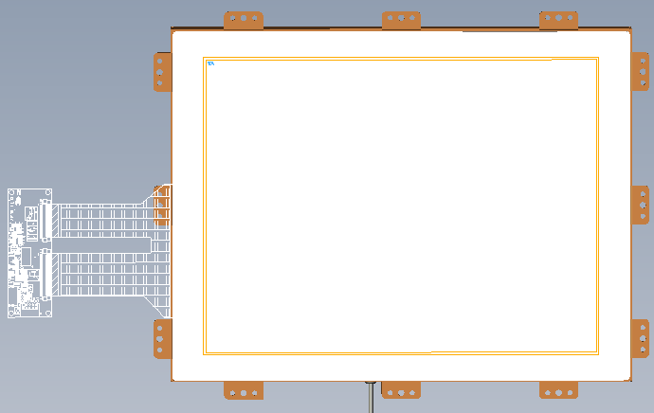
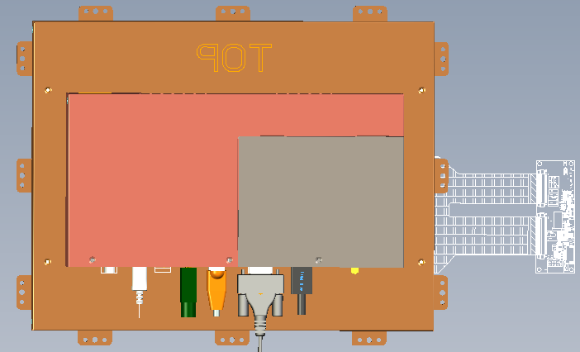
OFT-XX02 EVT Placement

